Slide 1
World life expectancy
Presented by Ang Li

Slide 2
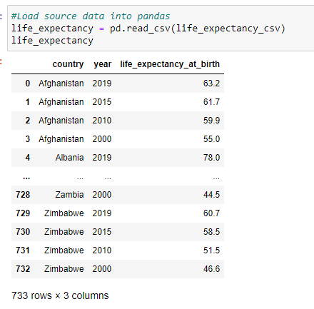
Extract -- Data Source and Format
WHO
– Life Expectancy by Country.CSV
WHO
– Death Risk Factor.CSV
World Bank
– GDP by Country.CSV

Slide 3
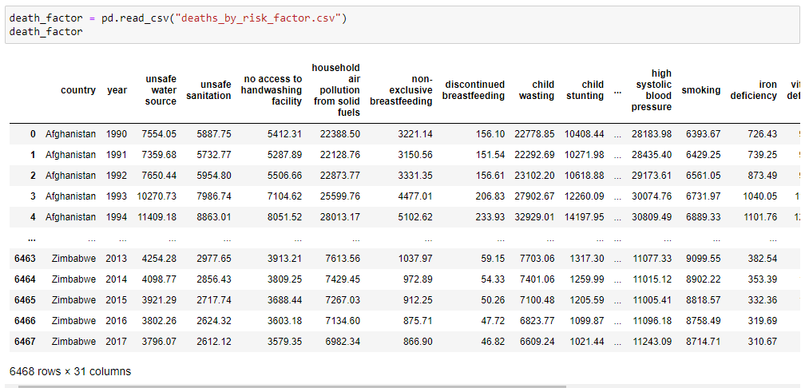
Extract -- Data Source and Format
WHO
– Life Expectancy by Country.CSV
WHO
– Death Risk Factor.CSV
World Bank
– GDP by Country.CSV

Slide 4
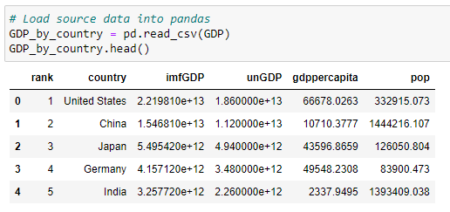
Extract -- Data Source and Format
WHO
– Life Expectancy by Country.CSV
WHO
– Death Risk Factor.CSV
World Bank
– GDP by Country.CSV

Slide 5
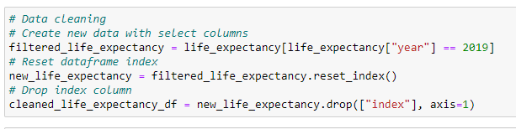
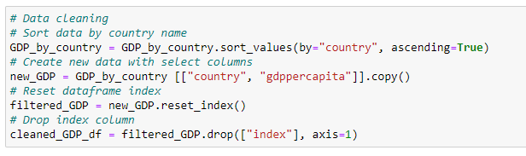
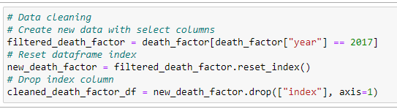
Transform -- Data Cleanup
Filter & drop columns
Sort values
Clean dataframe

Slide 6
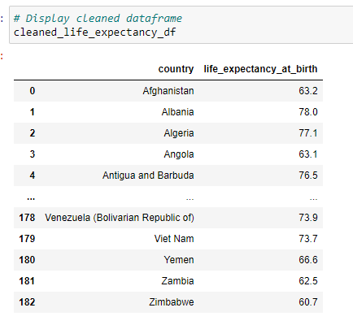
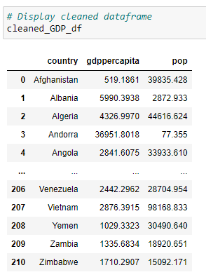
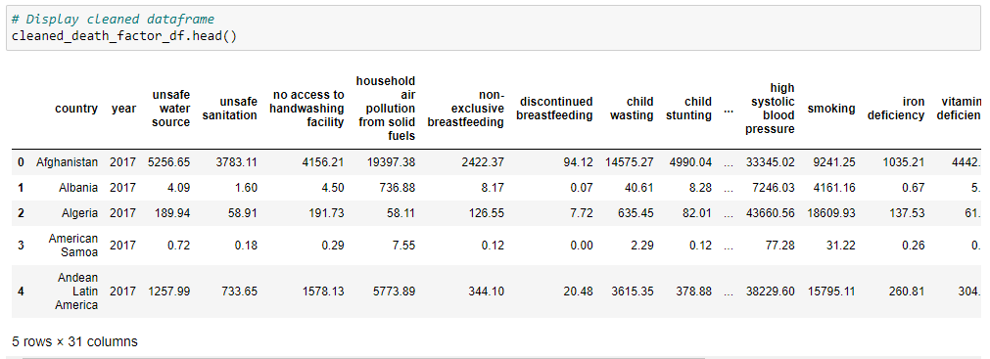
Transform -- Data Cleanup
Cleaned dataframe

Slide 7

Load -- PostgreSQL
Relational Data

Slide 8
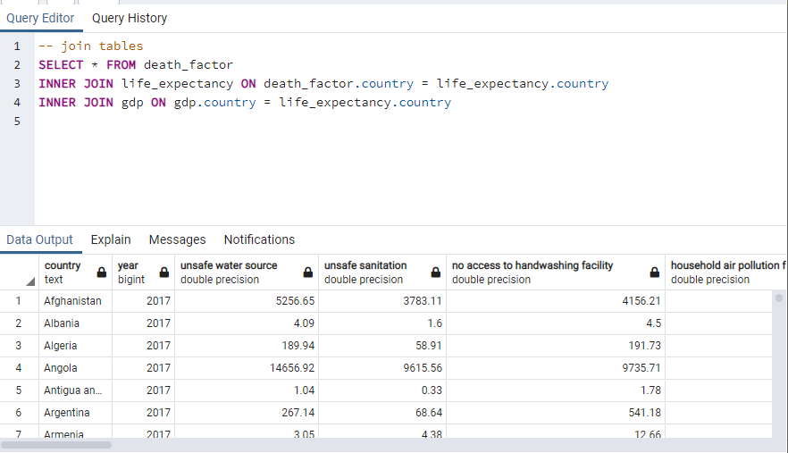
Load -- PostgreSQL
Join Tables
Run Queries for Further Analysis

Slide 9
The End

